Slide 1
Unit 3—Lesson 2:
Type Casting and Inspection

Slide 2
Type inspection
func getClientPet() -> Animal {
//returns the pet
}
let pet = getClientPet() //`pet` is of type `Animal`
Notes:
Say
If a function returns a class that has subclasses, we may need to know how to ask which subclass it is:
func getClientPet() -> Animal

Slide 3
Type inspection
if pet is Dog {
print("The client's pet is a dog")
} else if pet is Cat {
print("The client's pet is a cat")
} else if pet is Bird {
print("The client's pet is a bird")
} else {
print("The client has a very exotic pet")
}
Notes:
Note
Shows the "is" syntax:
if pet is Dog {}

Slide 4
Type inspection
let pets = allPets() //`pets` is of type `[Animal]`
var dogCount = 0, catCount = 0, birdCount = 0
for pet in pets {
if pet is Dog {
dogCount += 1
} else if pet is Cat {
catCount += 1
} else if pet is Bird {
birdCount += 1
}
}
print("Brad looks after \(dogCount) dogs, \(catCount) cats, and \(birdCount) birds.")
Notes:
Say
Here’s another example.

Slide 5
Type casting
Type casting in Swift is the process of converting an object from one type to another.
The syntax of type casting in Swift is as follows:
expression as Type
let stringValue = "hello"
let intValue = 42
let doubleValue = Double(intValue) // 42.0
let stringDoubleValue = Double(stringValue) // This will fail and return nil
The first typecast converts an integer to a Double.
The second typecast tries to convert a string “hello” to a Double. Since “hello” is not a number, the typecast fails and returns nil.

Slide 6
Type Casting
Upcasting and Downcasting:
Upcasting: Converting a subclass instance to its superclass type. This is safe and implicit.
Downcasting: Converting a superclass instance to a subclass type. This requires explicit casting and can fail if the instance isn't of the target subclass type.
Type Casting Operators:
as? (Conditional Downcast): Attempts to downcast and returns an optional. If the downcast fails, it returns nil.
as! (Forced Downcast): Forces a downcast and triggers a runtime error if it fails. Use only when you're certain of the instance's type.
is (Type Check): Checks if an instance is of a certain type and returns a Boolean value.

Slide 7
Type Casting Operators
Operator | Purpose | Result Type
is | Check if an instance is of a certain subclass type. | Bool
as? | Conditional cast. Returns nil if the cast fails. | Optional (Type?)
as! | Forced cast. Crashes your app if the cast fails. | Non-optional (Type)

Slide 8
Downcasting vs. Upcasting
Downcasting is used to convert a value from a superclass type to a subclass type. The syntax for downcasting is as follows:
let instance = superclassValue as? SubclassType
The as? operator is used to perform a downcast and returns an optional value of type SubclassType. If the downcast is successful, the optional will contain the downcasted value, otherwise it’ll be nil.
Upcasting is used to convert a value from a subclass type to a superclass type. The syntax for upcasting is as follows:
let instance: SuperclassType = subclassValue as SuperclassType
The as operator is used to perform an upcast. If the upcast is successful, the expression will be of type SuperclassType, otherwise it’ll cause a compile-time error.

Slide 9
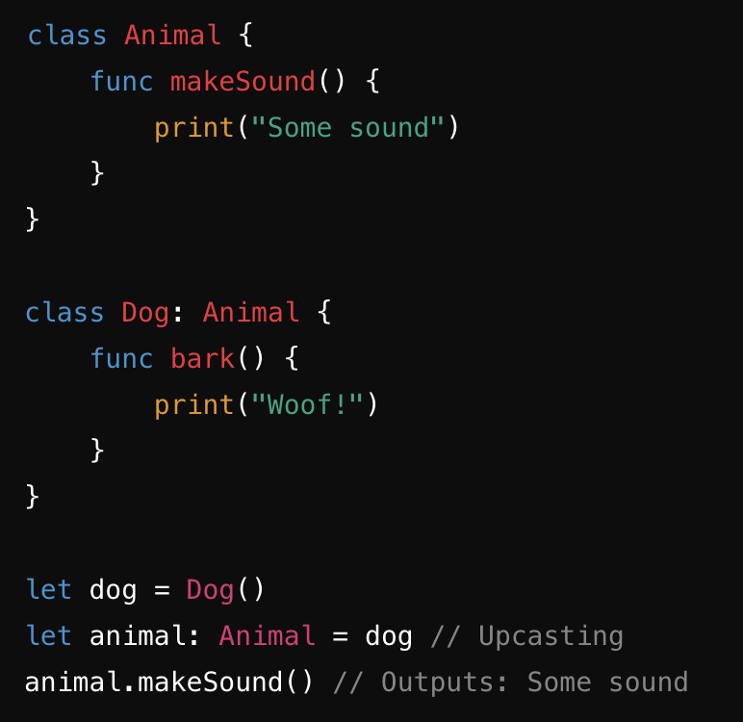
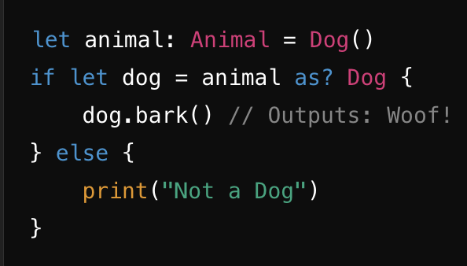
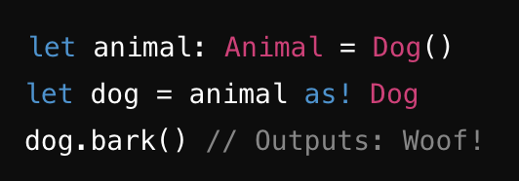
Upcasting
Downcasting
Downcasting with as?
Downcasting with as!

Slide 10
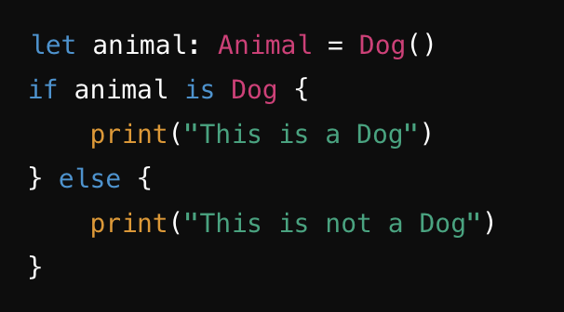
Using is for Type Checking

Slide 11
Type casting
func walk(dog: Dog) {
print("Walking \(dog.name)")
}
func cleanLitterBox(cat: Cat) {. . .}
func cleanCage(bird: Bird) {. . .}
for pet in pets {
if pet is Dog {
walk(dog: pet) // Compiler error. The compiler sees `pet` as an `Animal`, not a `Dog`.
}
. . .
}
Notes:
Say
Sometimes we have a type that's too vague, and we need to tell or ask the compiler that we know—or want to know—if it can be more precise.
If we have a function that takes "Dog" and we have an instance that's "Animal," the compiler complains.
So we need to:
Ask if it's a Dog
Tell the compiler that we know it's a Dog

Slide 12
Type casting
for pet in pets {
if let dog = pet as? Dog {
walk(dog: dog)
} else if let cat = pet as? Cat {
cleanLitterBox(cat: cat)
} else if let bird = pet as? Bird {
cleanCage(bird: bird)
}
}
Notes:
Say
if let theDog = pet as? Dog {}
If "pet" is of type "Dog," then the code runs.
Remember, Swift says that "?" may be nil and "!" may crash.

Slide 13
Type casting
class SecondViewController : UIViewController {
var names: [String]?
}
func prepare(for segue: UIStoryboardSegue, sender: Any?) {
let secondVC = segue.destination as! SecondViewController
secondVC.names = ["Peter", "Jamie", "Tricia"]
}
Notes:
Say
The slide shows that SecondViewController is a UIViewController subclass.
Do
Go to the docs and show that the destination property of UIStoryboardSegue is UIViewController.
Say
We built the UI, so we know that the destination is really an instance of SecondViewController.
What if we're wrong? Answer: A crash will occur.
Remember: Swift says "?" means "may be nil," and "!" means "may crash"—so be sure!

Slide 14
Any
Homogenous collections are simpler to work with because you know the type of every instance within them.
But what if you want to work with nonspecific types?
Swift provides two special types: Any and AnyObject.
As the name implies, Any can represent an instance of any type: strings, doubles, functions, or whatever.
AnyObject can represent an instance of any class in Swift but not a structure
var items: [Any] = [5, "Bill", 6.7, Dog()]
Notes:
Say
Although Swift is strongly typed, you can specify a nonspecific type, when appropriate.
"Any" is any type.
AnyObject is any class.
If a collection is "Any" or "AnyObject," you may need to do introspection.

Slide 15
Any
var items: [Any] = [5, "Bill", 6.7, Dog()]
let firstItem = items[0]
if firstItem is Int {
print("The first element is an integer")
} else if firstItem is String {
print("The first element is a string")
} else {
print("The first element is neither an integer nor a string")
}
Notes:
Note
Shows "is" introspection.

Slide 16
Any
var items: [Any] = [5, "Bill", 6.7, Dog()]
if let firstItem = items[0] as? Int {
print(firstItem + 4)
}
9
Notes:
Say
As we saw with optionals, if/let also works with "as?".
Being type-specific is better when possible—the compiler can help you avoid errors—but "Any" and "AnyObject" are OK when necessary.

Slide 17
Casting with Switch
In Swift, type casting is done using the is and as operators. When working with a switch statement, you can use type casting to check the type of a value at runtime and perform different actions based on the actual type.
is Operator: Checks if a value is of a specific type.
as? Operator: Attempts to cast a value to a specific type (returns an optional).
as! Operator: Forcefully casts a value to a specific type (crashes if the cast fails).

Slide 18
Example
let animals: [Animal] = [Dog(), Cat(), Dog()]
for animal in animals {
switch animal {
case let dog as Dog: // Cast to Dog
dog.bark()
case let cat as Cat: // Cast to Cat
cat.meow()
default:
print("Unknown animal")
}
}
class Animal {}
class Dog: Animal {
func bark() {
print("Woof! Woof!")
}
}
class Cat: Animal {
func meow() {
print("Meow! Meow!")
}
}
OUTPUT:
Woof! Woof!
Meow! Meow!
Woof! Woof!
NOTE: This is a useful way to handle multiple types in a structured way,
avoiding the need for multiple if let or guard let statements.

Slide 19

Unit 3—Lesson 2
Lab: Type Casting and Inspection
Open and complete the exercises in Lab - Type Casting.playground

Slide 20
Notes:
L569805A-en_WW App Development with Swift © 2021 Apple Inc. This work is licensed by Apple Inc. under the Creative Commons Attribution-NonCommercial-ShareAlike 4.0 International license (https://creativecommons.org/licenses/by-nc-sa/4.0/legalcode).

